Slide 1


Slide 2
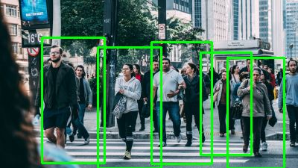
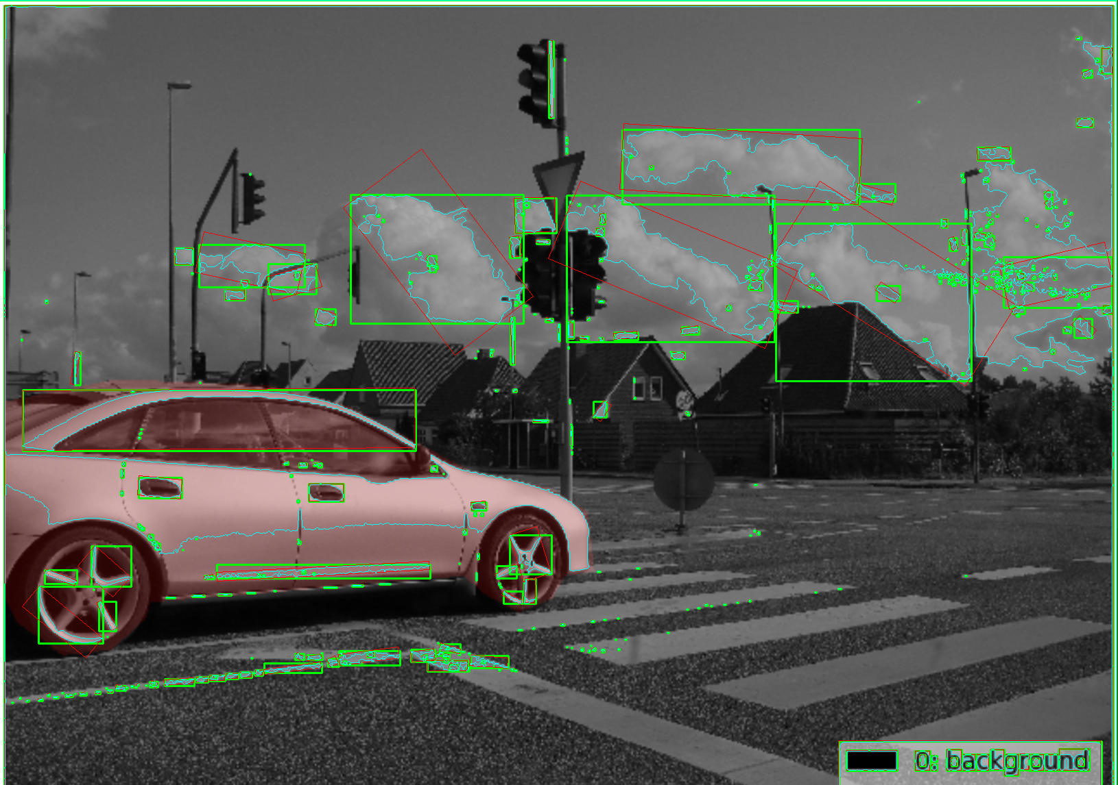
What is OpenCV ?
Opencv is an open source library which is very useful for computer vision applications such as video analysis, CCTV footage analysis and image analysis.

Slide 3



Why OpenCV ?
Cross platform supported. (Windows, Linux, Mac, Android etc)
Support many Deep Learning framework like Tensorflow, PyTorch, Caffe.

Slide 4

Convolutional Neural Network (CNN)
A convolutional neural network (CNN) is a type of artificial neural network used in image recognition and processing that is specifically designed to process pixel data.

Slide 5
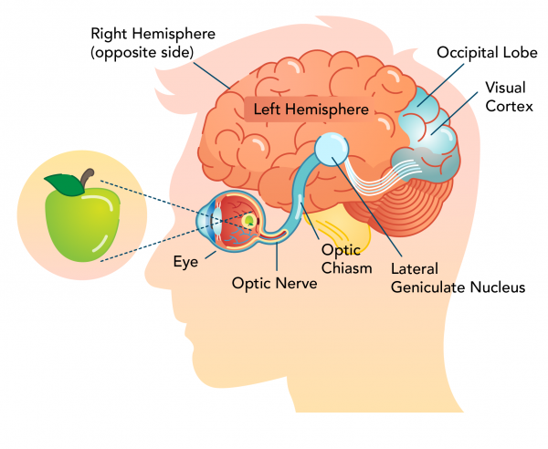
How CNN works?
Visual Cortex
Image/Object

Slide 6
Where to use
Power Image Search Service
Self Driving Car
Automatic Video Classification System
Natural Language Processing
Voice Recognition

Slide 7
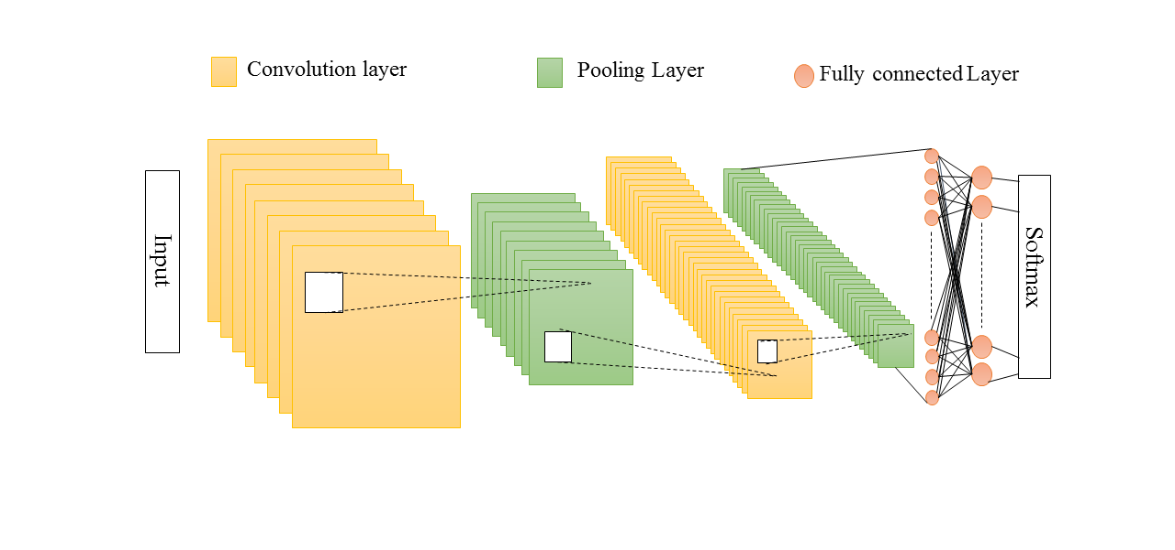
CNN Architecture (Different Layer)
A CNN mainly comprised of three layers namely convolutional layer, pooling layer and fully connected layer.
Features Extraction
Classification

Slide 8
The End

